Slide 1
Finite State Automata

Slide 2
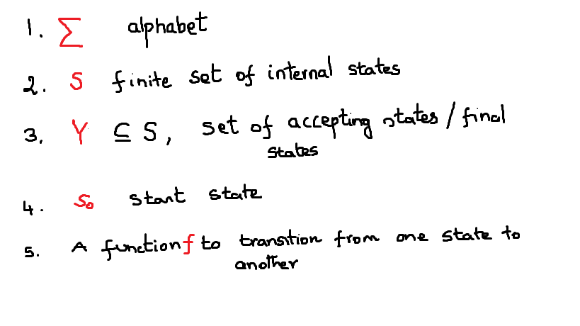
Finite State Automaton
FSA is a type of mathematical machine for designed to check if a string is contained within some language.
FSA has five parts

Slide 3
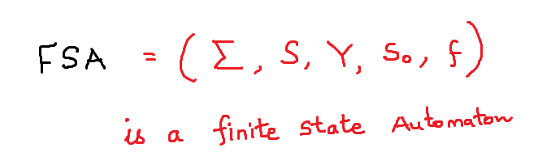

Slide 4
Each finite state automaton contains a set of states and transitions.
Each state is represented by a circle
The first state is the start state
The are many final or accepting states marked with double circles.
The automaton run on an input string
For each alphabet in the string, it transitions to a different or same state.
The transitions are defined by the FSA
After transitioning to a state, it reads the next alphabet in the string
When it finally reaches the end of the string, it should be in accepting state to indicate the string is accepted. If it is not in the accepting state, the string is considered to be rejected by the FSA

Slide 5
The automaton can only be in one state at a time.
It begins with the start state
When it is processing the input string, it can only move forward. It cannot reverse to process the alphabet again.
At each state, the automaton should define the transition for each alphabet.

Slide 6
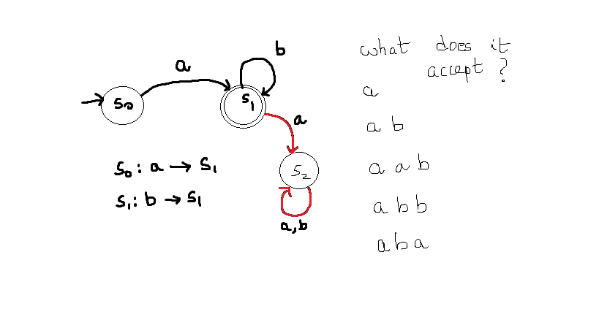

Slide 7
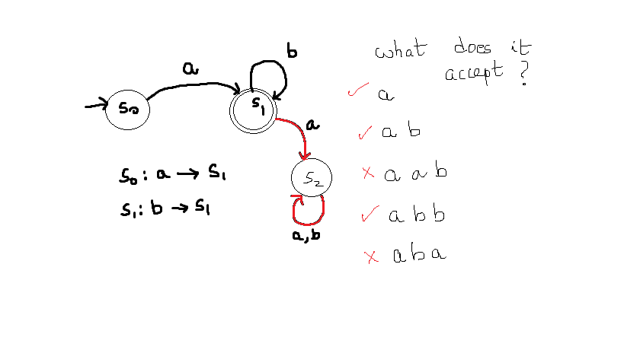

Slide 8
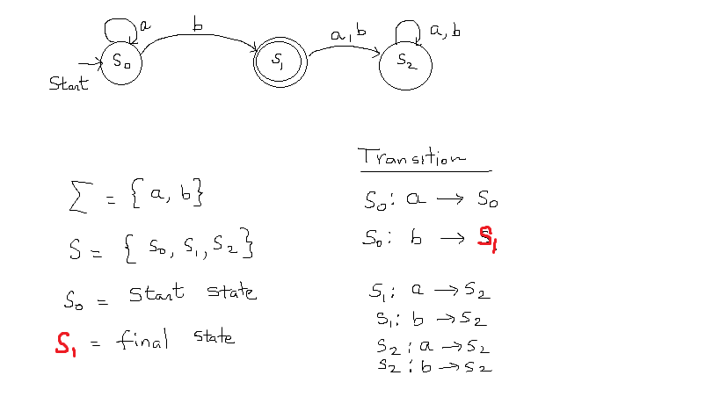

Slide 9
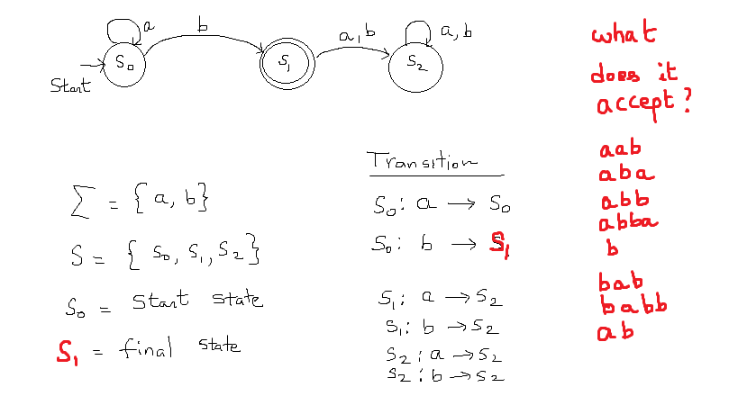

Slide 10
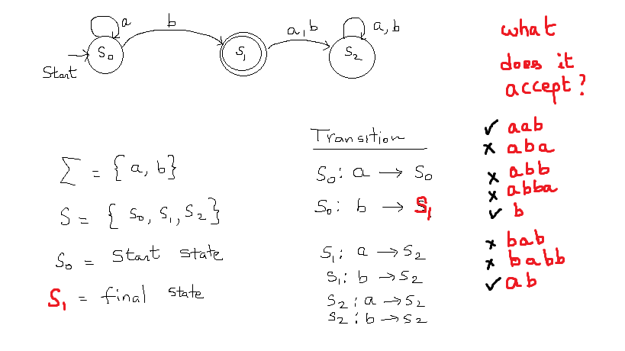

Slide 11
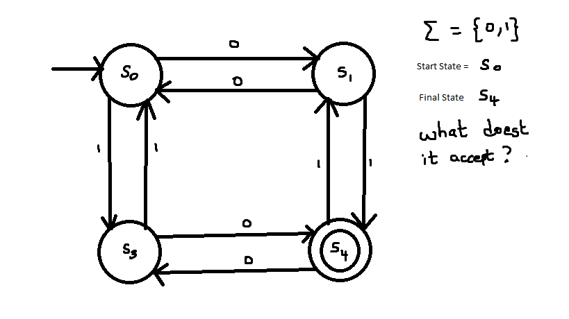

Slide 12
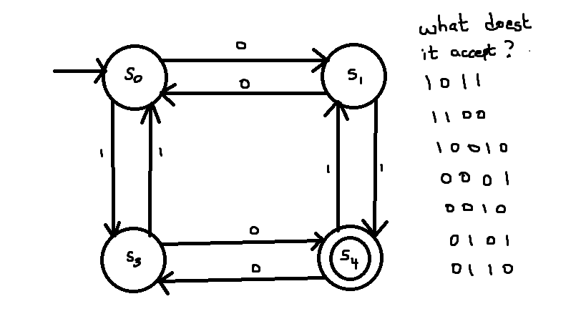

Slide 13
